Slide 1
Jetblue Customer Feedback
By ellie, Brianna, Sarah, and Tobi

Slide 2
Our mission
… to provide customers with an easier way of voicing their questions and concerns, regarding JetBlue Airlines.

Slide 3
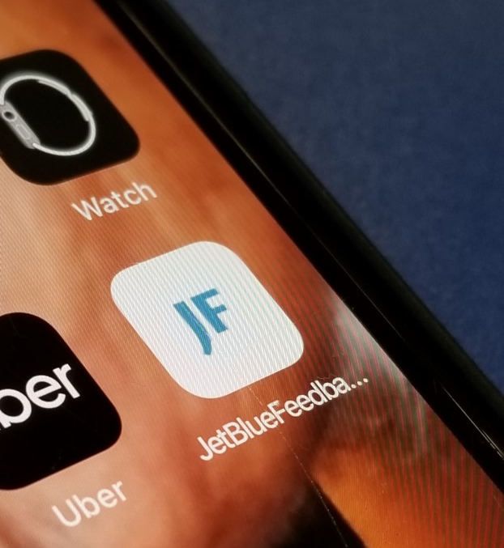
JetBlue feedback was our solution...

Slide 4
We submitted 40 mock responses through the app
…the responses appeared in Ellie’s email and, as they came in, we transferred the exact responses into an Excel Spreadsheet, so the data was easier to look at and put to use. We purposefully made the majority of the comments negative and made the reason behind the negative comments the same – dasani water

Slide 5
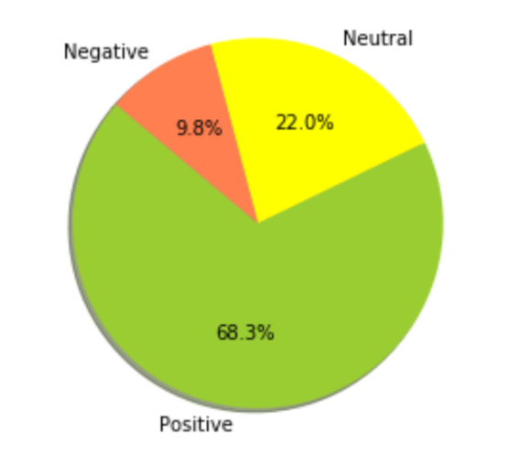
Here is the Sentiment analysis we built…

Slide 6
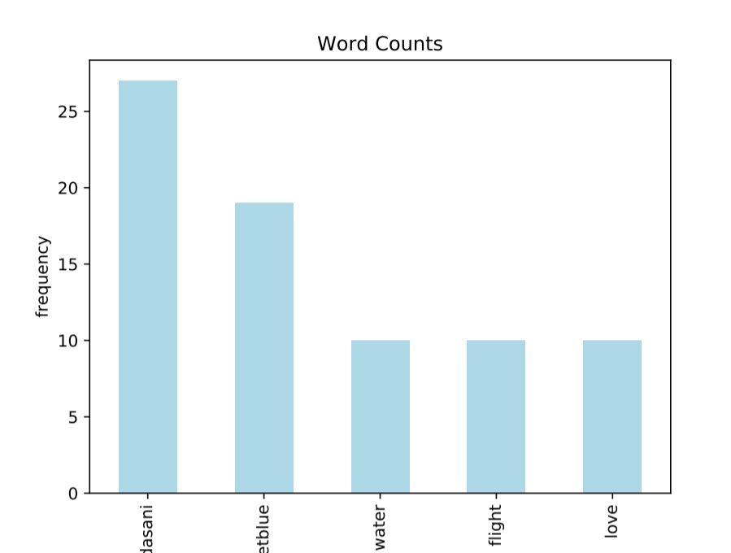
What was the reason behind why we received some negative comments?

Slide 7
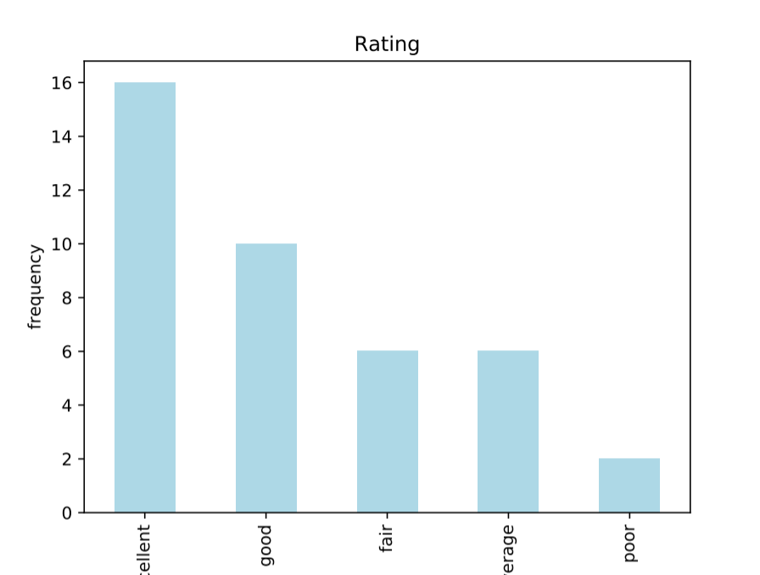
We also calculated the “grade’ that JetBlue received from the customers

